Slide 1
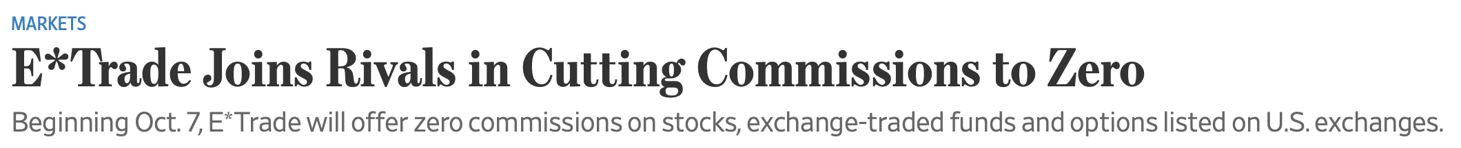
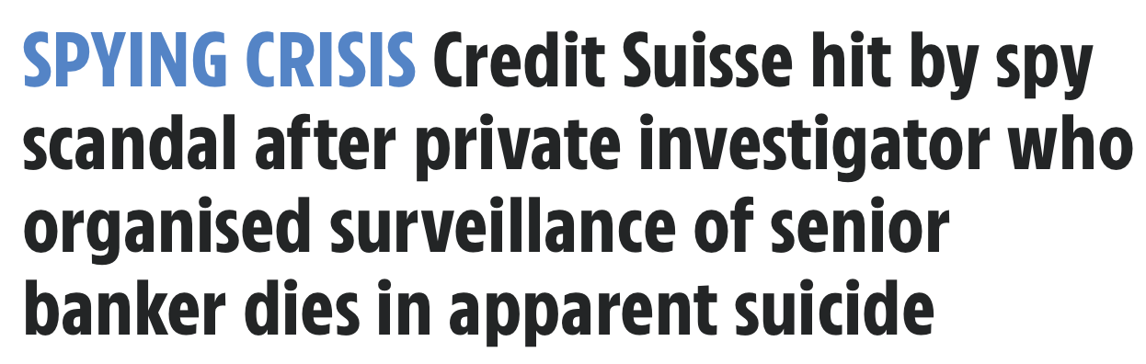
News

Slide 2
HMC and In Class Work
Notes:
35mins

Slide 3
HMC Optimal Portfolio
Let’s find HMC’s optimal portfolio
First, let’s review the case

Slide 4
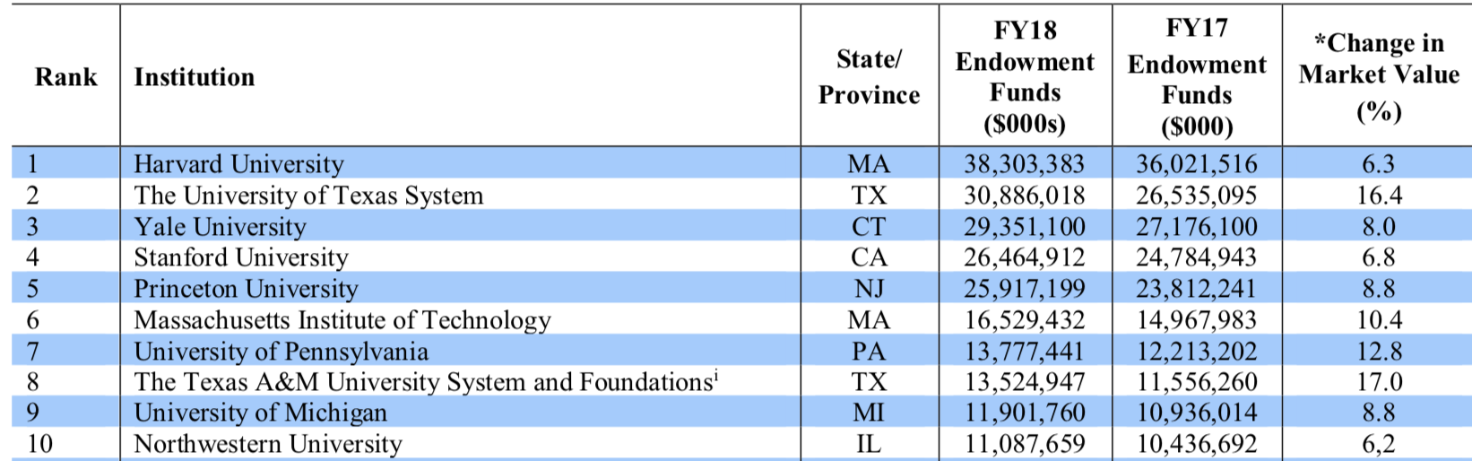
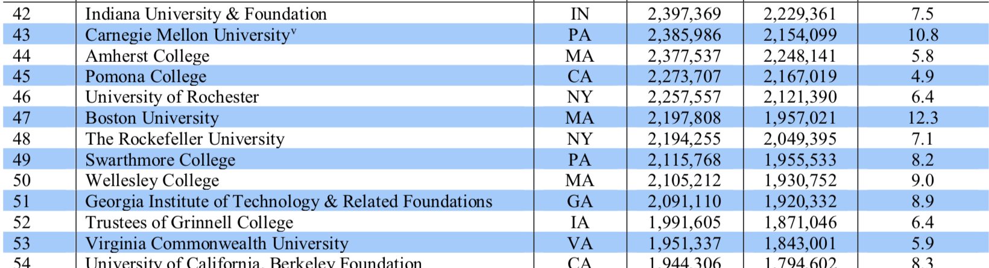
University Endowments
Source:
Nacubo.org
A 1% return on $38B = $380B, largest donation ever to Harvard: $400M by John Paulson
Notes:
http://www.nacubo.org/Research/NACUBO-Commonfund_Study_of_Endowments/Public_NCSE_Tables.html

Slide 5
Fun Facts
“The joke about Harvard is that it’s a hedge fund with a university attached to it,” Mark Schneider tells me.
“overseen by a team of in-house experts and spread across a mind-bending array of investments that range from stocks and bonds to California wine vineyards,”
“Is It Time to Tax Harvard’s Endowment”, Slate 2015
“Harvard Buys Up Water Rights in Drought-Hit Wine Country” Reuters, 2015

Slide 6
What is the objective of the fund?

Slide 7
HMC Case
In 2009: annual spending from endowment was ~37% of the total budget
4.0% of the value of the fund
General objective: try to preserve the real value of the endowment and its income distribution in perpetuity

Slide 8
What is the main task facing HMC in this case?
HMC is reviewing its Policy Portfolio
“The long-term asset mix that was designed to balance Harvard’s aversion to risk against its needs for long-term endowment returns.”

Slide 9
What are the main strategies to add value?
Two ways to add value:
Tactical asset allocation: bet on short-term asset class movements
HMC board puts min and max constraints on weights
Outperform benchmarks for a given asset class

Slide 10
Strategies to Outperform
Main strategy: find asset pairs that appear mispriced compared to one another
Buy the cheap and sell the expensive
Used Triple A credit rating to finance large positions and made them a preferred counterparty
Avoid “directional bets”
36% (64%) of assets were managed by external managers in 2000 (2009)
What are the benefits/costs of outside management of funds?
Notes:
How does someone assess quality of outside managers? Does investing in spinoffs help?

Slide 11
Policy Portfolio
HMC wants to create an optimal portfolio
They make predictions about the expected return and risks on various asset classes
What was this process?
Examine different allocations across asset classes to find an optimal portfolio
Notes:
45 mins

Slide 12
Let’s Calculate an Efficient Frontier
Use HMC Exhibit 17 on Canvas to calculate an efficient frontier
Use Solver:
For Mac:
Click Tools, and then click Add-Ins.
Click the Data Analysis ToolPak or Solver option to enable it. Then, click OK.
Locate Data Analysis ToolPak or Solver on the Data tab.
Minimize the standard deviation
Constrain the expected return to a specific value
Constrain weights to sum to 1
Cells to change: the portfolio weights
Find the optimal portfolio
Maximize the Sharpe ratio
Constrain weights to sum to 1
Cells to change: the portfolio weights

Slide 13
Efficient Frontier

Slide 14
Find optimal constrained portfolios:
No shorting
Near Policy Portfolio

Slide 15
Optimal Portfolio
 | Our Solution | 2010 Policy | No Shorting | Near policy
Dom Eq | -11% | 11% | 0% | 1%
For Eq | 7% | 11% | 0% | 1%
Em Mkt | -4% | 11% | 0% | 1%
Private Eq | 8% | 13% | 3% | 3%
Ab Ret | 26% | 16% | 20% | 24%
HY | -5% | 2% | 0% | -6%
Comm | 5% | 14% | 2% | 4%
Nat Res | 35% | - | 34% | 19%
Real Estate | 18% | 9% | 14% | 16%
Dom Bonds | 6% | 4% | 0% | 10%
For Bonds | -7% | 2% | 4% | 12%
IF Bonds | 22% | 5% | 23% | 15%
Notes:
1:05 mins

Slide 16
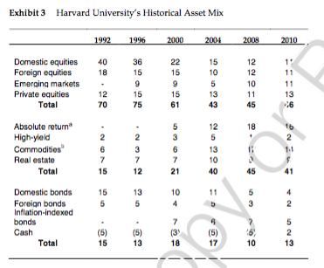

Slide 17
Questions
Why is HMC’s policy portfolio so different from the “optimal” weights we calculated?
What risks should HMC be most concerned about?
Why does Harvard seem hesitant to invest in the more complex asset classes?
Why does HMC put constraints on the policy portfolio?
Notes:
Was the current asset mix too reliant on relatively new and untested asset classes (e.g. emerging markets, timberland, and inflation-indexed bonds)?
Should HMC increase its allocation or decrease its allocation to external active managers?

Slide 18
Portfolio Considerations (not captured by Sharpe ratio)
Some portfolios too “non-traditional to be acceptable”
Calculate value at risks
Run stress tests to see how portfolio behaves in “extreme” situations like 1987 crash or 1998 widening of arbitrage spreads (LTCM)
In 2010, Jane Mendillo is very concerned about illiquidity and leverage
What were the sources of illiquidity?
What were the sources of leverage?
Should she have been concerned?
Notes:
2016 Report: “Additionally, in order to provide continuous and reliable funding to the University in various market conditions, we need to manage our liquidity carefully, especially under stress scenarios, to ensure that at least 5% of the endowment can be realized in liquid form within 30 days. “

Slide 19
Additional Considerations

Slide 20
ESG
“As a long-term investor, HMC is focused on environmental, social, and governance (ESG) factors that may affect the performance of our investments—now and in the future. Aligned with our mission to provide strong long-term investment results to Harvard University, we include material ESG criteria in our investment analysis and decision-making processes. “
Three-pronged approach to sustainable investment: ESG integration, active ownership and collaboration
http://www.hmc.harvard.edu/investment-management/
sustainable_investment.html#esgIntegration

Slide 21
ESG
Principles for Responsible Investment¹
1. We will incorporate ESG issues into investment analysis and decision-making processes.
2. We will be active owners and incorporate ESG issues into our ownership policies and practices.
3. We will seek appropriate disclosure on ESG issues by the entities in which we invest.
4. We will promote acceptance and implementation of the Principles within the investment industry.
5. We will work together to enhance our effectiveness in implementing the Principles.
6. We will each report on our activities and progress towards implementing the Principles.
http://www.hmc.harvard.edu/investment-management/
sustainable_investment.html#esgIntegration

Slide 22
ESG
Should ESG be a factor in HMC’s investment decision?
Should it be a major factor?
What are the trade-offs?

Slide 23
Costs of Sustainability
Herzel, Nicolosi and Starica (2012):
“Analysis covered an investment set containing the components of the S&P500 index from 1993 to 2008.”
“Eliminated companies that did not comply with certain ESG criteria”
“Socially responsible screening gives rise to a small loss in terms of Sharpe ratio”
“Differences… are significant only in the case of environmental screening”

Slide 24
Costs to Firms
Chava (2014):
“I find that investors demand significantly higher expected returns on stocks excluded by environmental screens (such as hazardous chemical, substantial emissions, and climate change concerns) compared to firms without such environmental concerns. Lenders also charge a significantly higher interest rate on the bank loans issued to firms with these environmental concerns”
“Cogan (2008) reports that many large, publicly traded banks across the world have started to incorporate climate change concerns in their lending decisions,”
Notes:
“The data source for the firm-level environmental pro- file is KLD Stats. This database has information on environmental concerns and environmental strengths for a large sample of firms rated by KLD Research & Analytics, Inc., now a part of MSCI.”

Slide 25
Since 2010…

Slide 26
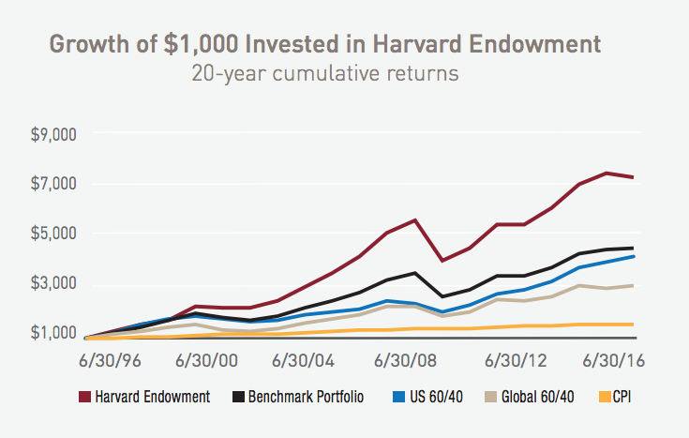
Performance
HMC Report 2016

Slide 27
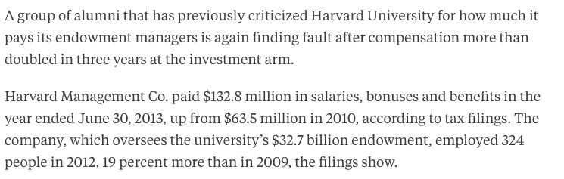
Compensation
“Members of the class of 1969 have been critical of the compensation at Boston-based Harvard Management since 2003 when the university disclosed that its five highest-paid endowment employees got a combined $100 million in one year, including about $35 million each for two traders. The controversy prompted some alumni to threaten to withhold donations and preceded the departure of Jack Meyer, who ran the endowment for 15 years.”

Slide 28
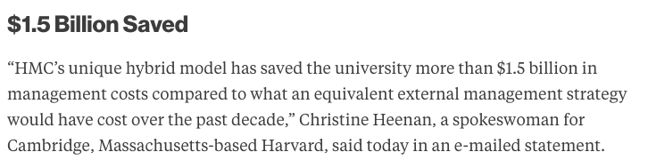
Compensation
http://www.bloomberg.com/news/articles/2014-08-27/harvard-endowment-compensation-sparks-letter-from-alumni
In 2010, the university said it would alter compensation, tying senior management pay to the entire fund’s performance while reducing bonuses if there were negative returns. It said more than 90 percent of the pay was tied to returns and that bonuses often reflected several years of gains and losses relative to a benchmark.
“HMC’s overarching compensation strategy is to maximize alignment of interests between our investment management teams and the university,” Mendillo wrote in a 2010 letter to the school’s alumni.

Slide 29
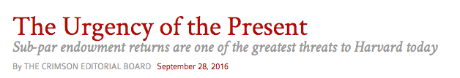
Recent Performance
http://www.thecrimson.com/article/2016/9/28/endowment-loss-2016/
“Specifically, Harvard Management Company announced a $2 billion loss for fiscal year 2016… Let’s not mince words: this is unacceptable… Over the past several years, Harvard’s endowment returns have failed to keep pace with peer schools’ returns. In fiscal year 2015, Harvard ranked penultimate among Ivy League institutions, with Princeton besting Harvard Management Company by nearly seven points. ”

Slide 30
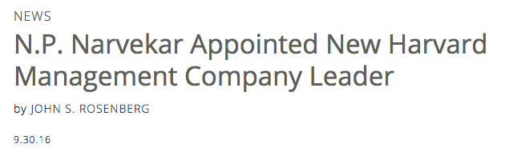
..the University announced that N.P. Narvekar, chief executive officer of Columbia University Investment Management Company
“Narvekar, who has been in his Columbia role since 2002, is credited with improving performance there…Columbia’s compound annualized rate of return for the 10 years through fiscal 2015 (the latest year reported) was 10.1 percent. For the same period, HMC’s annualized rate of return was 7.6 percent - and for the decade ending this past June 30, that declined to 5.7 percent,”
“… its new chief executive will lay off half of the investment group’s 230 employees
and transfer more money to outside firms…”
Boston Globe

Slide 32
2019: Harvard Management Company returned 6.5 percent on its investments for fiscal year 2019, bringing the value of the University’s endowment to $40.9 billion. Harvard has lagged behind its Ivy League peers in recent years and fell short of Dartmouth’s 7.5 percent return this year. Dartmouth and the University of Pennsylvania are the only Ivy League institutions that have reported their fiscal year 2019 returns so far.
2018:
“But Harvard — as it did last year — is still trailing those of its Ivy League peers who have posted their returns. The University’s 2018 results fall short of the University of Pennsylvania’s returns, which clocked in at 12.9 percent, and Dartmouth’s returns of 12.2 percent.”
“Since Narvekar took the helm of HMC in December 2016, the endowment has shifted from a “silo” model — in which managers focus on individual asset classes — to a generalist model, in which managers are responsible for the entire portfolio and compensated for overall performance. Narvekar has also moved to downsize HMC and outsource some investments, including spinning off the school’s real estate division to Bain Capital..."

